Slide 1

Event Sourcing, DDD & CQRS

Slide 2
Plan
Event Sourcing
Domain-driven design (DDD)
DDD vs Event Sourcing
Command Query Responsibility Segregation (CQRS)
Event Sourcing vs CQRS
Conclusion

Slide 3
Event Sourcing

Slide 4
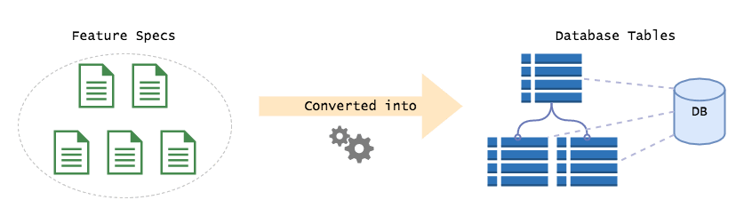
Problematic
When we design web apps, we immediately translate the specs into concepts from our storage mechanism. If it's MySQL we design the tables, if it's MongoDB, we design the documents. This forces us to think of everything in terms of current state.
"How do I store this thing so I can retrieve (and potentially change) it later?".

Slide 5
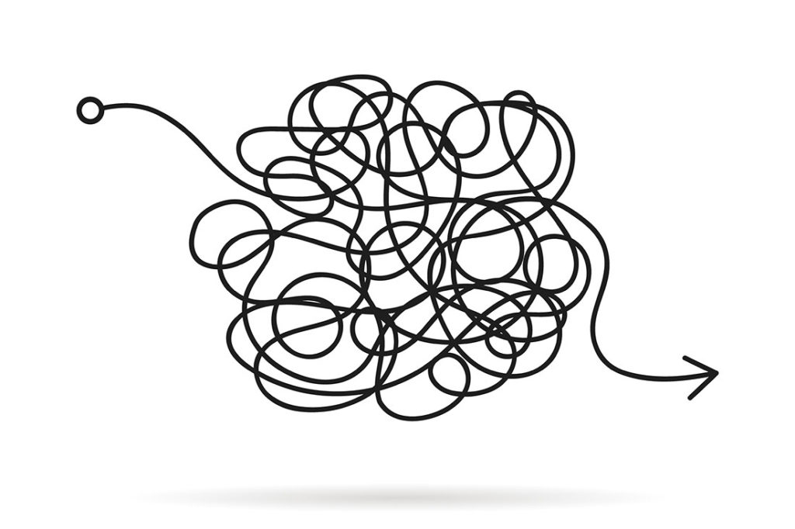
Problems
1. It's not how we think
2. Single data model
3. We lose business critical information
Notes:
1. It's not how we think
We as a species do not think or communicate in terms of state. When I meet you for a coffee and ask "What's happening?", you don't tell me the current state of the world and then expect me to figure out what's changed, that would be insane.
"Well, I have a house, a car, a refrigerator, three social media accounts, a cat, a pain in my right foot, the crippling self-doubt that I'm terrible at conversations, another cat ...etc"
See what I mean? That's crazy. In reality you'd tell me the new things that have happened since we last talked, and from that I'm able to figure out how your world looks now. In short, you tell me a story, and a story at it's simplest is a sequence of events.
2. Single data model
In the above we use the same model for both reads and writes. Typically we'd design our tables from a write perspective, then figure out how to build our queries on-top of those structures. This works for well small apps, but becomes problematic in large ones. You see, it's next to impossible to build a generic model that is optimised for both reads and writes. As the system grows, the queries will get more and more complex, eventually hitting a point where every query contains 10 joins and is 100 lines long. This soon becomes unmaintainable, brittle and expensive to change.
3. We lose business critical information
This is a big one. With a standard table driven system, you're only storing the current state of the world, you have no idea how your system got into that state in the first place. If I were to ask you "How many times has a user changed their email address" could you answer it? What about "How many people added an item to their cart, then removed it, then bought that item a month later"? That's a lot of useful business information that you're losing because of how you happen to store your data!

Slide 6
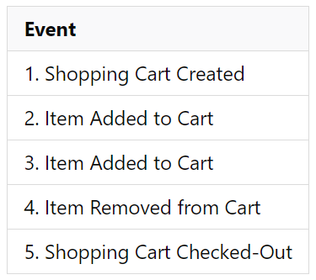
Event Sourcing (ES) is opposite of this.
Notes:
Instead of focussing on current state, you focus on the changes that have occurred over time. It is the practice of modelling your system as a sequence of events.
Let's give an example. Say we have the concept of a "Shopping Cart". We can create a cart, add items to it, remove them, and then check it out.
And there we go, that's the full lifecycle of an actual cart, modelled as a sequence of events. That is Event Sourcing. Simple huh!

Slide 7
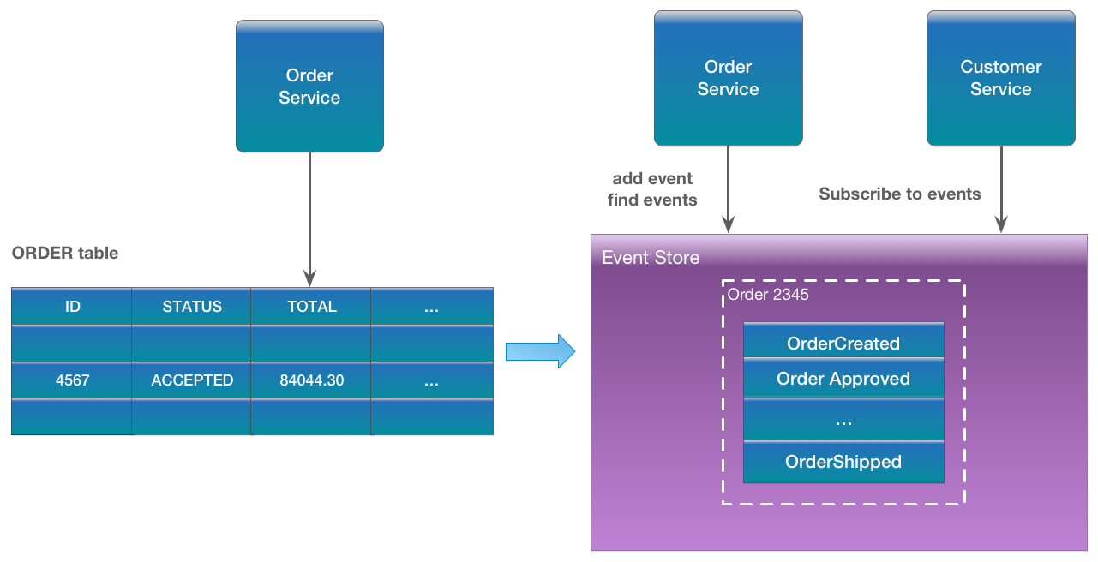
Example: Order Entity
Notes:
Event sourcing persists the state of a business entity such an Order or a Customer as a sequence of state-changing events. Whenever the state of a business entity changes, a new event is appended to the list of events. Since saving an event is a single operation, it is inherently atomic. The application reconstructs an entity’s current state by replaying the events.
Applications persist events in an event store, which is a database of events. The store has an API for adding and retrieving an entity’s events. The event store also behaves like a message broker. It provides an API that enables services to subscribe to events. When a service saves an event in the event store, it is delivered to all interested subscribers.
Some entities, such as a Customer, can have a large number of events. In order to optimize loading, an application can periodically save a snapshot of an entity’s current state. To reconstruct the current state, the application finds the most recent snapshot and the events that have occurred since that snapshot. As a result, there are fewer events to replay.

Slide 8
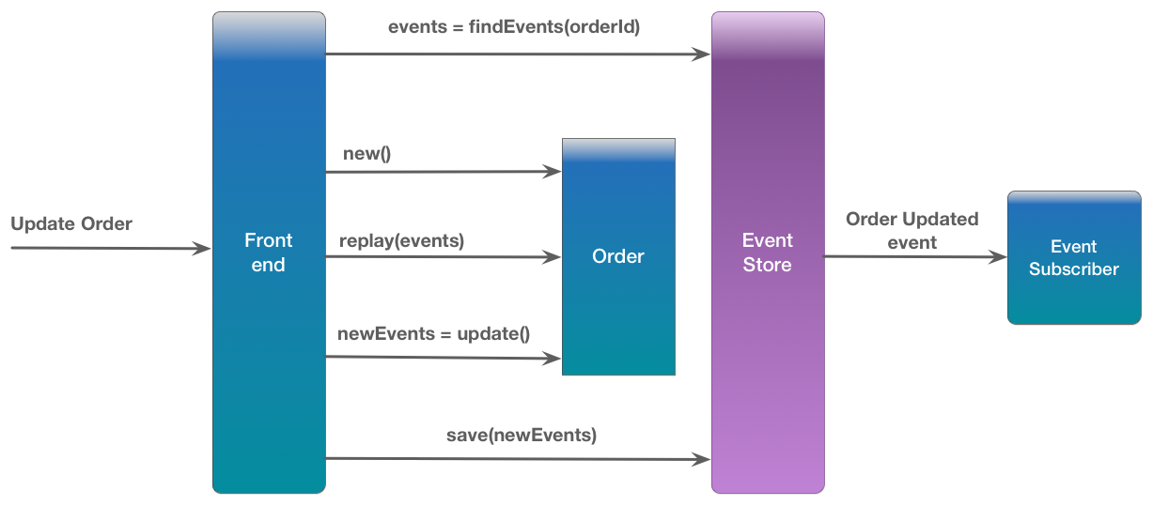
How the Order Service handles a request to update an Order

Slide 9
Event sourcing persists the state of a business entity such an Order or a Customer as a sequence of state-changing events
Whenever the state of a business entity changes, a new event is appended to the list of events.
The application reconstructs an entity’s current state by replaying the events.
Applications persist events in an event store, which is a database of events.
.The store has an API for adding and retrieving an entity’s events.
The event store also behaves like a message broker.
To optimize loading, an application can periodically save a snapshot of an entity’s current state
Notes:
Event sourcing persists the state of a business entity such an Order or a Customer as a sequence of state-changing events. Whenever the state of a business entity changes, a new event is appended to the list of events. Since saving an event is a single operation, it is inherently atomic. The application reconstructs an entity’s current state by replaying the events.
Applications persist events in an event store, which is a database of events. The store has an API for adding and retrieving an entity’s events. The event store also behaves like a message broker. It provides an API that enables services to subscribe to events. When a service saves an event in the event store, it is delivered to all interested subscribers.
Some entities, such as a Customer, can have a large number of events. In order to optimize loading, an application can periodically save a snapshot of an entity’s current state. To reconstruct the current state, the application finds the most recent snapshot and the events that have occurred since that snapshot. As a result, there are fewer events to replay.

Slide 10

How do you enforce business rules?
Isn't this expensive and time consuming?
What about showing data to the user?
If every piece of state is derived from events, how do you fetch data that needs to be presented to the user? Do you fetch all the events and build the dataset each time?
Notes:
#1
Most business operations have constraints, a hard rule that cannot be broken.
How you answer every question about state in an event sourced system, you replay a subset of the events to get the answer you need. The is usually called projecting the events, and the end result is a "projection".
#2
Not at all. To enforce constraints, you typically only need the tiniest subset of events. Fetching the useful history of a concept, such as a Cart, is typically a single database call. You load the events and replay them in memory, "projecting" them, to build up your dataset. This is lighting fast, as you're doing it on the local processor, rather than making a series of SQL calls (network calls are insanely slow compared to local operations, by at least two orders of magnitude!).
#3
The answer is no, you don't, that would be ridiculous.
Instead of building it on the fly, you build it in the background, storing the intermediate results in a database. That way, users can query for data, and they will get it in the exact shape they need, with minimal delay. In effect, you cache the results for later use

Slide 11
The benefits
1. Ephemeral data-structures.
2. Easier to communicate with domain experts
3. Expressive models
4. Reports become painless
5. Composing services becomes trivial
6. Lightning fast on standard databases
7. Easy to change database implementations
Notes:
The benefits
We've looked at a few of the benefits all ready, but lets go deeper, because believe me, this style of development offers a host of benefits that I can no longer live without.
1. Ephemeral data-structures.
Since all state is derived from events, you are no longer bound by the current "state" of your application. If you need to view data in a new way, you simply create a new projection of the data, projecting it into the shape you need.
2. Easier to communicate with domain experts
As I said before, domains experts don't think in terms of state, they express business processes as a series of events. By building an event sourced system, we're modelling the system exactly as they describe it, rather than translating it into tech concepts and losing information.
3. Expressive models
Event Sourcing forces you to model events as first class objects, rather than through implicit state changes. This means your models will closely resemble the actual processes you're modelling. This brings a lot of clarity to the table and stops you getting lost in the details of your storage technology. It makes the implicit explicit.
4. Reports become painless
Generating complex business reports becomes a walk in the park in an event sourced system. You have the full history of every event that has ever happened, in chronological order, this means you can ask any question you like about that data historically.
Think of the power of this! Take the earlier example, you want to know how many users removed an item from their cart and then bought it a week later. In a standard web app this would take weeks of development, and once it's released, you have to wait for the data to populate before you could generate the report. With an ES system, it's built in from the get go, so you can generate that report right now. You could also generate the report for any previous point in the time. In other words, you have a time machine.
5. Composing services becomes trivial
In standard web dev, plugging two systems together is usually quite tricky, and it frequently leads to tight coupling. ES solves this problem by letting services communicate via events. Need to trigger a process in another service when something happens? Write an event listener that runs whenever that event is fired. This allows you to add new integrations/functionality, without having to modify existing domain code.
6. Lightning fast on standard databases
You don't need to use a fancy database to store your events, a standard MySQL table will do just fine. Databases are optimised for append only operations, which means that storing data is fast, while modifying data is slow. This is why ES works so well with current tech, events are append only.
7. Easy to change database implementations
Due to the ephemeral nature of event sourced data-structures, you now have full freedom to use any database technology you like to store state. This means you get to choose the best tool for the job. And If you find a better tool, and you can switch to it at any point, there is zero commitment. This gives you an incredible amount of freedom. Case in point, we're currently moving some of our more complex projections from MySQL to OrientDB, and so far it's been a breeze.

Slide 12
The issues
1. Eventual Consistency
2. Event Upgrading
3. Developers need deprogramming
Notes:
The issues
Like anything, ES is not a free lunch. Here are some of the surprises you will run into.
1. Eventual Consistency
An ES system is naturally eventually consistent. This means that whenever an event occurs, other systems won't hear about it immediately, there is a short delay (say ~100ms) before they receive and process the event, gaining consistency. This means that you can't guarantee that the data in your projections is immediately up-to-date. This sounds like a big deal, but it really isn't. Modern web dev apps built on ReactJS will build up state from actions as the user performs operations, so having a query side that's lagging a few milliseconds is a non issue.
2. Event Upgrading
Events will change shape over time, and this can be a bit tricky to handle if you don't plan for it in advance. When an event changes shape, you have to write an upgrader that takes the old event and converts it into the new one. This is done on the fly when you read the events from the store. Think of them as migrations for your events. Not as difficult as it sounds, just have a strategy in place for upgrading events and you'll be fine.
3. Developers need deprogramming
The status quo in web dev is state driven development, this means developers will immediately jump to thinking in tables, rather than events. I've found it takes time to "deprogram" developers, they need to unlearn all the bad habits they've picked up. This usually manifest as events that are pure CRUD and don't mirror the domain language. The best way to combat this is to pair new developers with experienced ESers.

Slide 13
Wrapping it up
Event Sourcing solves all the big problems our team has faced when building large scale distributed business software. It allows us to talk to the business in their language, and it gives us the freedom to change and adapt the system with ease. Throw in built in business analytics and you've got a winning combination. There is a learning curve, but once you get into Event Sourcing, you'll never want to look back, I know I don't.

Slide 14
Domain-driven design (DDD)

Slide 15

Problematic
When we face complex problems, we usually try to understand the individual pieces of complexity. By decomposing the problem, we turn it into more understandable and manageable pieces.
Notes:
As is described in many product/project management cycles, for real life problems, this is usually driven by instinct. We don't use a formula to understand what is required to travel to a country that requires a visa. We learn that we need a visa to travel, we slowly grasp the documentation needs, what forms are to be filled and how to fill these. When we handle one of the steps, we don't keep all the details of the process in our minds, we just do the task at hand. This is related to the size of the tasks to accomplish.

Slide 16
What is Domain-Driven Design?
Domain-driven design (DDD) is an approach to developing software for complex needs by deeply connecting the implementation to an evolving model of the core business concepts.
Its premise is:
Place the project’s primary focus on the core domain and domain logic
Base complex designs on a model
Initiate a creative collaboration between technical and domain experts to iteratively cut ever closer to the conceptual heart of the problem.
Notes:
Initially introduced and made popular by programmer Eric Evans in his 2004 book, Domain-Driven Design: Tackling Complexity in the Heart of Software, domain-driven design is the expansion upon and application of the domainconcept, as it applies to the development of software.
The premise is simple, but pulling it off in the messy real world is hard. It calls for new skills and discipline, and a systematic approach.
Domain-driven design is not a technology or a methodology. DDD provides a structure of practices and terminology for making design decisions that focus and accelerate software projects dealing with complicated domains.

Slide 17
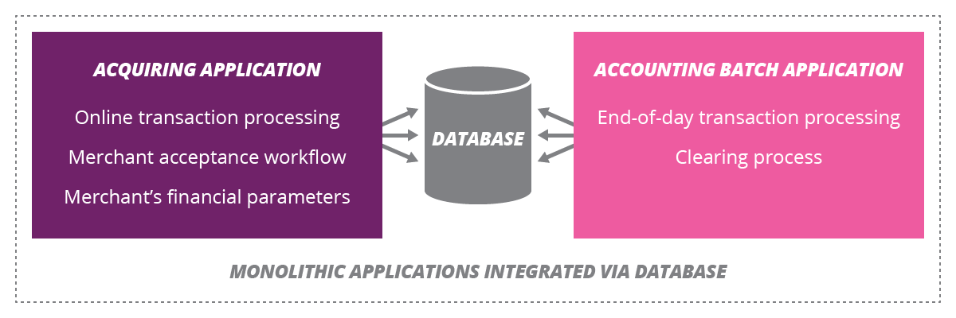
Example: debit/credit card
Notes:
This domain could be (as is the case many times, unfortunately) realized as a set of monolithic applications. The only reason that we have multiple applications is due to the hard technical limitations (such as a desire to execute batch processes) in different applications.
Most successful architectures that I have seen, recognize that integrating through databases is a bad practice, as it makes the boundary between technical application and business responsibility blurry, allows business logic to leak into the database and prevents horizontal scaling by adding more application servers. So the evolution to a better architecture happens in the form of service integration of monolithic applications.

Slide 18
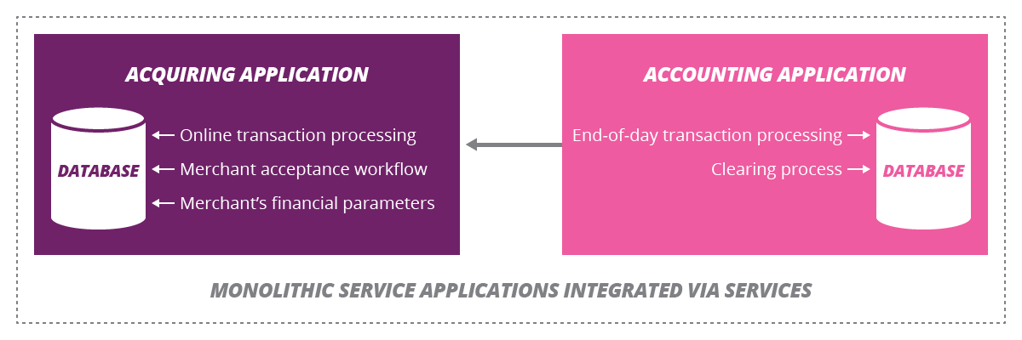
Notes:
Now the boundaries between applications are clearer. But as you can see, there are still hidden DB interations, this time happening inside the individual applications. I call them hidden as they are generally hard to notice at first. As time passes, tangling of the code will make originally- separated business processes related artificially and introduce more friction in business development, as this co-location requires joint deployment of separate features which potentially can slow down the pace.

Slide 19
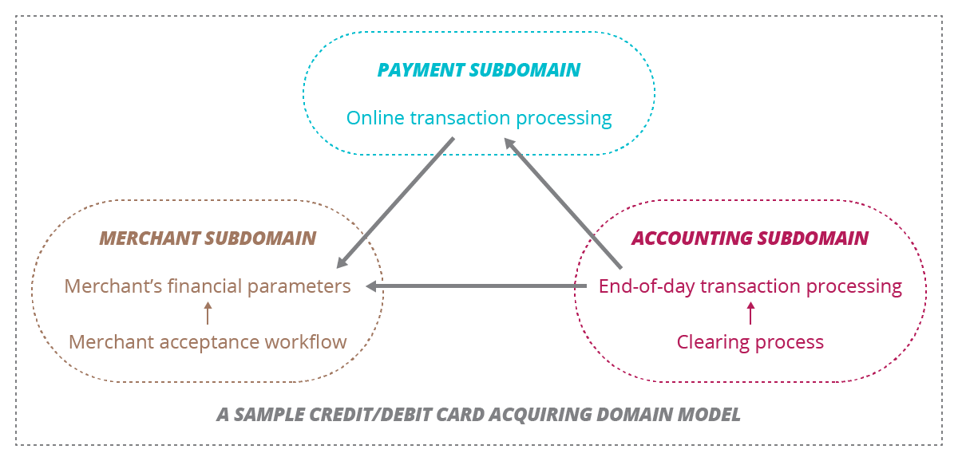
Notes:
Domain modeling helps to identify and separate tangled implementations, if you are lucky to have a domain model to guide you. If you don't already have a domain model for an existing application (which is generally true in most cases), instead of going through the code to understand the different responsibilities, building a domain model and mapping the capabilities to the application at hand can probably be a better approach. This will both save time and prevent the risk of being lost in the weeds of detail. Also, if there is a gap between the business and the development team (which could be the major reason that the domain model didn’t exist in the first place), talking about the domain model and mapping to the capabilities of existing applications will help narrowing this gap.

Slide 20
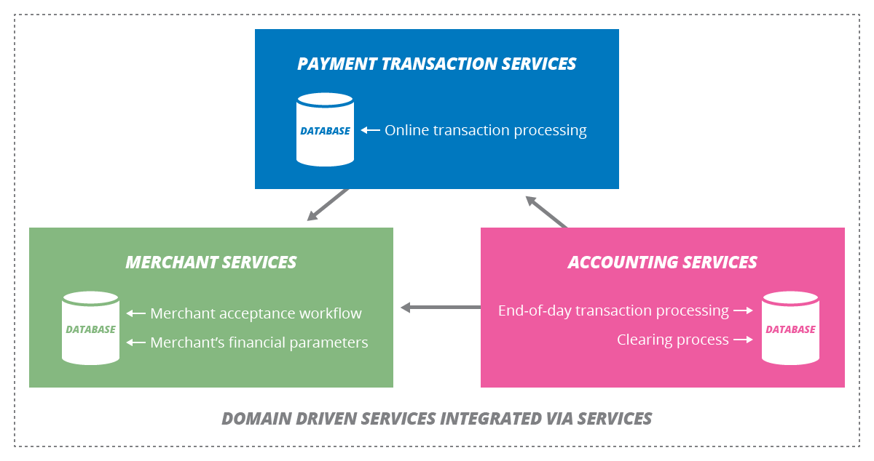
Notes:
The next step in our design evolution is to reflect domain boundary separation to our architecture as well as bounded contexts. A domain having more than one bounded context means that there can be multiple service applications which operate in the same domain. With the proper domain model in place, potential separation points are more visible, which allows us to benefit from potentially more granular applications (benefits such as separate release and versioning, potential to have more capability-driven pure service endpoints etc.
This will also provide a level of independence to the teams, more refined capabilities of services and more decoupled interactions as explained in many microservices texts.

Slide 21
DDD common terms
Context: The setting in which a word or statement appears that determines its meaning. Statements about a model can only be understood in a context.
Model: A system of abstractions that describes selected aspects of a domain and can be used to solve problems related to that domain.
Ubiquitous Language: A language structured around the domain model and used by all team members to connect all the activities of the team with the software.
Bounded Context: A description of a boundary (typically a subsystem, or the work of a specific team) within which a particular model is defined and applicable.

Slide 22
Approach to architecture. Defining responsibilities and splitting project on logical layers
Application layer
Domain layer
Infrastructure layer
Notes:
Application layer is responsible for high level logic. When we look at application layer we can see calls to “lower” levels (domain, infrastructure...). Logic in this layer should be easy to read. Also this is place where transaction scope and validation are handled. We are validating input arguments, opening transaction, doing some high level stuff and closing transaction so everything is atomic (this is just an example, transaction is not necessary nor all logic should be in transaction).
Domain layer is representation of business rules, validation handling (validation in context of domain) and everything that have business logic in it. As I understand, entities, value objects and services are also here. This layer is on same “depth” as infrastructure, both are called by application layer but domain layer can also call infrastructure.
Infrastructure layer is place where is done communication with external systems, storing and providing data (repositories)...

Slide 23
Beside from layers we have concepts of entities, value object, services and modules.
Entities
Value objects
Domain Event
Aggregate
Services
Repositories
Modules
Factories
Notes:
Entity: An object that is identified by its consistent thread of continuity, as opposed to traditional objects, which are defined by their attributes.
Value Object: An immutable (unchangeable) object that has attributes, but no distinct identity.
Domain Event: An object that is used to record a discrete event related to model activity within the system. While all events within the system could be tracked, a domain event is only created for event types which the domain experts care about.
Aggregate: A cluster of entities and value objects with defined boundaries around the group. Rather than allowing every single entity or value object to perform all actions on its own, the collective aggregate of items is assigned a singular aggregate root item. Now, external objects no longer have direct access to every individual entity or value object within the aggregate, but instead only have access to the single aggregate root item, and use that to pass along instructions to the group as a whole. This practice correlates with many of the actual coding practices we’re covering in our design patterns series.
Service: Essentially, a service is an operation or form of business logic that doesn’t naturally fit within the realm of objects. In other words, if some functionality must exist, but it cannot be related to an entity or value object, it’s probably a service.
Modules are basically grouped parts of the system that have some kind of relation (in domain logical sense). When we put few classes in module we are telling next developer who are looking in this module that those classes should be observed as a whole.
Repositories: Not be confused with common version control repositories, the DDD meaning of a repository is a service that uses a global interface to provide access to all entities and value objects that are within a particular aggregate collection. Methods should be defined to allow for creation, modification, and deletion of objects within the aggregate. However, by using this repository service to make data queries, the goal is to remove such data query capabilities from within the business logic of object models.
Factories: As we’ve discussed through a number of design patterns articles already, DDD suggests the use of a factory, which encapsulates the logic of creating complex objects and aggregates, ensuring that the client has no knowledge of the inner-workings of object manipulation.

Slide 24
Advantages of Domain-Driven Design
Eases Communication
Improves Flexibility
Emphasizes Domain Over Interface
Notes:
Eases Communication: With an early emphasis on establishing a common and ubiquitous language related to the domain model of the project, teams will often find communication throughout the entire development life cycle to be much easier. Typically, DDD will require less technical jargon when discussing aspects of the application, since the ubiquitous language established early on will likely define simpler terms to refer to those more technical aspects.
Improves Flexibility: Since DDD is so heavily based around the concepts of object-oriented analysis and design, nearly everything within the domain model will be based on an object and will, therefore, be quite modular and encapsulated. This allows for various components, or even the entire system as a whole, to be altered and improved on a regular, continuous basis.
Emphasizes Domain Over Interface: Since DDD is the practice of building around the concepts of domain and what the domain experts within the project advise, DDD will often produce applications that are accurately suited for and representative of the domain at hand, as opposed to those applications which emphasize the UI/UX first and foremost. While an obvious balance is required, the focus on domain means that a DDD approach can produce a product that resonates well with the audience associated with that domain.

Slide 25
Disadvantages of Domain-Driven Design
Requires Robust Domain Expertise
Encourages Iterative Practices
Suited for Highly Technical Projects
Notes:
Requires Robust Domain Expertise: Even with the most technically proficient minds working on development, it’s all for naught if there isn’t at least one domain expert on the team that knows the exact ins and outs of the subject area on which the application is intended to apply. In some cases, domain-driven design may require the integration of one or more outside team members who can act as domain experts throughout the development life cycle.
Encourages Iterative Practices: While many would consider this an advantage, it cannot be denied that DDDpractices strongly rely on constant iteration and continuous integration in order to build a malleable project that can adjust itself when necessary. Some organizations may have trouble with these practices, particularly if their past experience is largely tied to less-flexible development models, such as the waterfall model or the like.
Ill-Suited for Highly Technical Projects: While DDD is great for applications where there is a great deal of domain complexity (where business logic is rather complex and convoluted), DDD is not very well-suited for applications that have marginal domain complexity, but conversely have a great deal of technical complexity. Since DDD so heavily emphasizes the need for (and importance of) domain experts to generate the proper ubiquitous language and then domain model on which the project is based, a project that is incredibly technically complex may be challenging for domain experts to grasp, causing problems down the line, perhaps when technical requirements or limitations were not fully understood by all members of the team.

Slide 26
Wrapping it up
Main thing is decoupling business logic from rest of the system and creating healthy model. Creating healthy model consider a lot of talking with domain experts and understanding domain on level needed for creating successful software. We don’t have to understand low level details about domain but we need to recognize purpose of the software and to shape model around domain knowledge.

Slide 27
DDD vs Event Sourcing

Slide 28

Why domain events and event sourcing should not be mixed up
Let’s consider the following example: in a domain for bike sharing, a user wants to register in order to rent a bike. Of course one also has to pay for it, which is done through a pre-paid approach using a wallet.

Slide 29
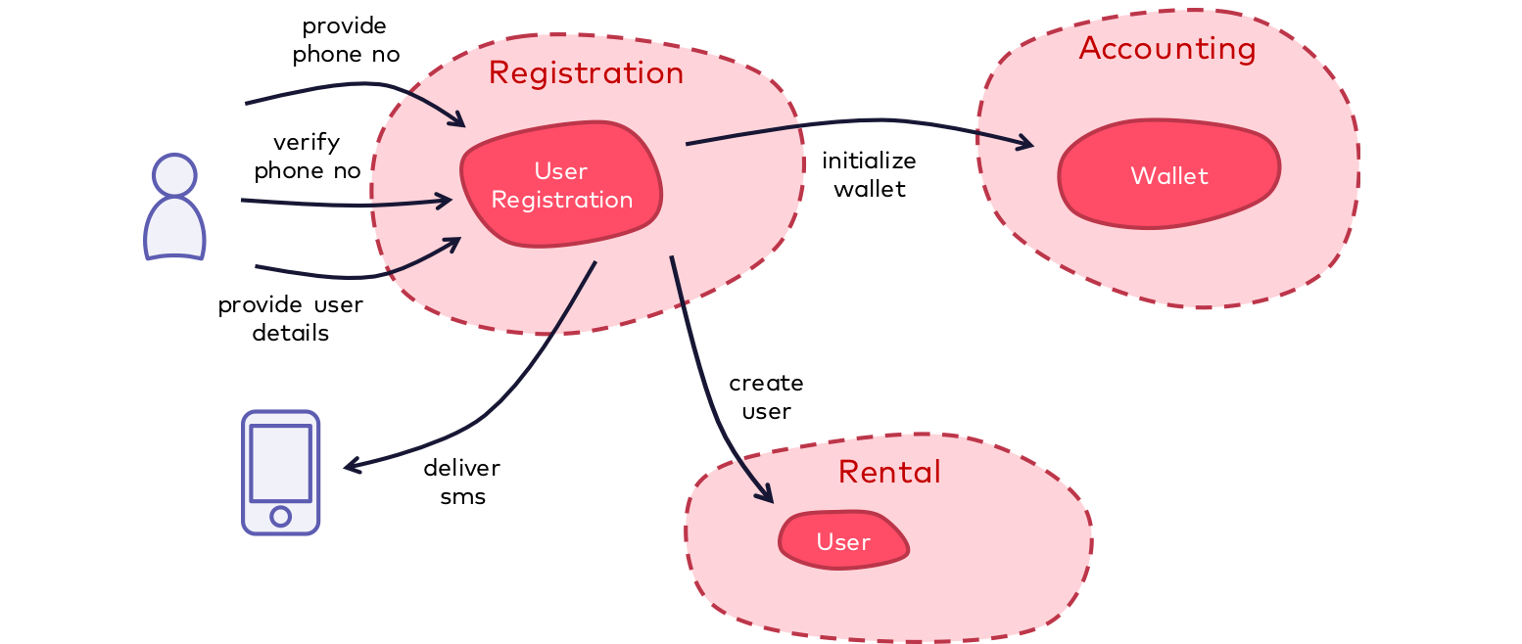
Events from Event Sourcing ≠ Domain Events

Slide 30
The registration process works as follows:
The user enters his/her mobile number through the mobile app.
The user receives an SMS code to confirm the phone number.
The user enters the confirmation code.
The user enters the additional details such as full name or address and completes the registration.
Notes:
This process is implemented in the UserRegistration aggregate in the bounded context Registration. The user interacts with “his/her” instance of the UserRegistration aggregate several times over the course of the registration process. The state of the UserRegistration is built up step by step until the registration is completed successfully. Once done, the user should be able to charge the wallet and rent a bike.

Slide 31
If event sourcing is used
The following events (containing the corresponding relevant state) are created and persisted over time:
MobileNumberProvided (MobileNumber)
VerificationCodeGenerated (VerificationCode)
MobileNumberValidated (no additional state)
UserDetailsProvided (FullName, Address, …)
Notes:
These events are sufficient to reconstruct the current state of the UserRegistration aggregate at any time. Additional events are not necessary, in particular no event which would express that the registration is now completed. This fact is know to the UserRegistration aggregate due to its internal domain logic as soon as the UserDetailsProvided event has been processed. Accordingly, an instance of a UserRegistration can answer at any time whether the registration has already been completed or not.
In addition, each event only contains the state that is necessary to be able to reconstruct the state of the aggregate during replay. This is typically only that state that has been influenced by the invocation that triggered the event, that is, a kind of “diff”. From the point of view of event sourcing, it makes no sense to store additional state on an event that was not influenced by the invocation. So, even if an explicit event UserRegistrationCompleted were persisted, it would not contained any additional state.
Some proponents of event sourcing vote that exactly these events from event sourcing for the UserRegistration aggregate can also be published to other interested parties within or outside the bounded context and can thus trigger further domain logic or update some other state. In our example, these would be the two bounded contexts Accounting (for initializing the wallet) and Rental (for creating the registered user).

Slide 32
If this is to be done using the events from event sourcing, each consuming bounded context must
process these fine-granular events and know at least parts of the domain logic from the UserRegistration aggregate (e.g. after which event a user is considered fully registered).
combine several events to get the whole state required about the user (e.g. the phone number from MobileNumberProvided and additional details from UserDetailsProvided)
ignore events which are not of any interest in the respective bounded context (e.g. VerificationCodeGenerated or MobileNumberValidated to confirm the phone number)

Slide 33
This approach breaks the intended encapsulation between different parts of the system, leads to chatty communication between bounded contexts and thus increases the coupling between bounded contexts. The main reason is that the semantics of the fine-grained events from event sourcing is too low-level, both in terms of the event itself and the associated information (the “payload”).
Notes:
In my opinion, things are much improved if the UserRegistration aggregate would also publish a domain event UserRegistrationCompleted with all relevant information MobileNumber, FullName, and Address (but e.g. not VerificationCode) as a payload after the registration has successfully been completed. This domain event has the appropriate semantics to be easily processed by external bounded contexts without having to know any internals of the registration process.

Slide 34
Command Query Responsibility Segregation (CQRS)
Notes:
Segregate operations that read data from operations that update data by using separate interfaces. This can maximize performance, scalability, and security. Supports the evolution of the system over time through higher flexibility, and prevents update commands from causing merge conflicts at the domain level.

Slide 35
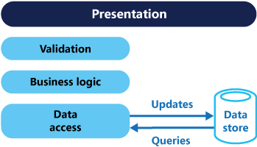
Problematic
Notes:
In traditional architectures, the same data model is used to query and update a database. That's simple and works well for basic CRUD operations. In more complex applications, however, this approach can become unwieldy. For example, on the read side, the application may perform many different queries, returning data transfer objects (DTOs) with different shapes. Object mapping can become complicated. On the write side, the model may implement complex validation and business logic. As a result, you can end up with an overly complex model that does too much.
Read and write workloads are often asymmetrical, with very different performance and scale requirements.

Slide 36
There is often a mismatch between the read and write representations of the data, such as additional columns or properties that must be updated correctly even though they aren't required as part of an operation.
Data contention can occur when operations are performed in parallel on the same set of data.
The traditional approach can have a negative effect on performance due to load on the data store and data access layer, and the complexity of queries required to retrieve information.
Managing security and permissions can become complex, because each entity is subject to both read and write operations, which might expose data in the wrong context.

Slide 37
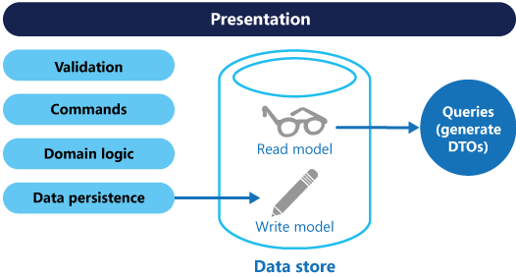
CQRS separates reads and writes into different models, using commands to update data, and queries to read data.
Commands should be task based, rather than data centric. ("Book hotel room", not "set ReservationStatus to Reserved").
Commands may be placed on a queue for asynchronous processing, rather than being processed synchronously.
Queries never modify the database. A query returns a DTO that does not encapsulate any domain knowledge.
Notes:
Having separate query and update models simplifies the design and implementation. However, one disadvantage is that CQRS code can't automatically be generated from a database schema using scaffolding mechanisms such as O/RM tools.

Slide 38
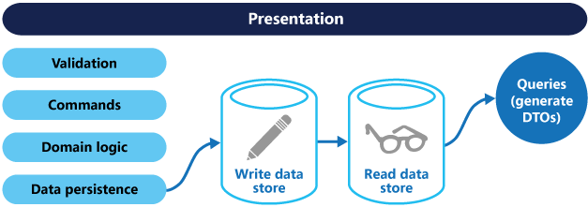
Separation of the read and write stores
Notes:
For greater isolation, you can physically separate the read data from the write data. In that case, the read database can use its own data schema that is optimized for queries.
If separate read and write databases are used, they must be kept in sync. Typically this is accomplished by having the write model publish an event whenever it updates the database. Updating the database and publishing the event must occur in a single transaction.
The read store can be a read-only replica of the write store, or the read and write stores can have a different structure altogether. Using multiple read-only replicas can increase query performance, especially in distributed scenarios where read-only replicas are located close to the application instances.
Separation of the read and write stores also allows each to be scaled appropriately to match the load. For example, read stores typically encounter a much higher load than write stores.

Slide 39
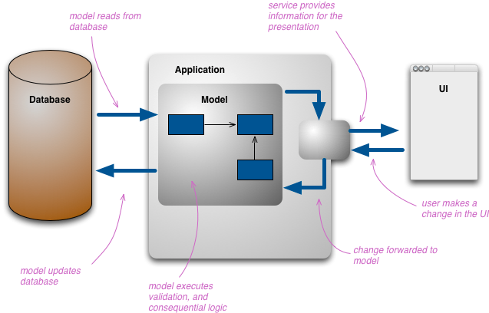
More general
Notes:
This structure of multiple layers of representation can get quite complicated, but when people do this they still resolve it down to a single conceptual representation which acts as a conceptual integration point between all the presentations.

Slide 40
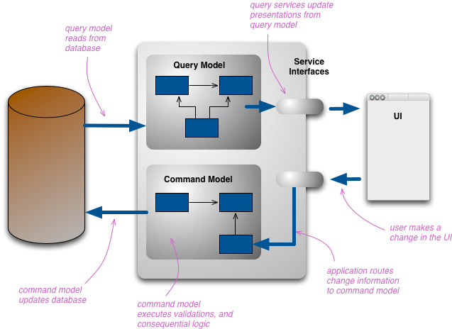
Notes:
The change that CQRS introduces is to split that conceptual model into separate models for update and display, which it refers to as Command and Query respectively following the vocabulary of CommandQuerySeparation. The rationale is that for many problems, particularly in more complicated domains, having the same conceptual model for commands and queries leads to a more complex model that does neither well.
By separate models we most commonly mean different object models, probably running in different logical processes, perhaps on separate hardware. A web example would see a user looking at a web page that's rendered using the query model. If they initiate a change that change is routed to the separate command model for processing, the resulting change is communicated to the query model to render the updated state.

Slide 41
Benefits
Independent scaling
Optimized data schemas
Security
Separation of concerns.
Simpler queries
Notes:
Independent scaling. CQRS allows the read and write workloads to scale independently, and may result in fewer lock contentions.
Optimized data schemas. The read side can use a schema that is optimized for queries, while the write side uses a schema that is optimized for updates.
Security. It's easier to ensure that only the right domain entities are performing writes on the data.
Separation of concerns. Segregating the read and write sides can result in models that are more maintainable and flexible. Most of the complex business logic goes into the write model. The read model can be relatively simple.
Simpler queries. By storing a materialized view in the read database, the application can avoid complex joins when querying.

Slide 42
Issues and considerations
Complexity
Messaging
Eventual consistency
Notes:
Complexity. The basic idea of CQRS is simple. But it can lead to a more complex application design, especially if they include the Event Sourcing pattern.
Messaging. Although CQRS does not require messaging, it's common to use messaging to process commands and publish update events. In that case, the application must handle message failures or duplicate messages.
Eventual consistency. If you separate the read and write databases, the read data may be stale. The read model store must be updated to reflect changes to the write model store, and it can be difficult to detect when a user has issued a request based on stale read data.

Slide 43
When to use this pattern
Collaborative domains where many users access the same data in parallel.
Task-based user interfaces where users are guided through a complex process as a series of steps or with complex domain models.
Scenarios where performance of data reads must be fine tuned separately from performance of data writes, especially when the number of reads is much greater than the number of writes.
Scenarios where one team of developers can focus on the complex domain model that is part of the write model, and another team can focus on the read model and the user interfaces.
Scenarios where the system is expected to evolve over time and might contain multiple versions of the model, or where business rules change regularly.
Integration with other systems, especially in combination with event sourcing, where the temporal failure of one subsystem shouldn't affect the availability of the others.

Slide 44
This pattern isn't recommended when:
The domain or the business rules are simple.
A simple CRUD-style user interface and data access operations are sufficient.

Slide 45
CQRS naturally fits with some other architectural patterns.
As we move away from a single representation that we interact with via CRUD, we can easily move to a task-based UI.
CQRS fits well with event-based programming models. It's common to see CQRS system split into separate services communicating with Event Collaboration. This allows these services to easily take advantage of Event Sourcing.
Having separate models raises questions about how hard to keep those models consistent, which raises the likelihood of using eventual consistency.
For many domains, much of the logic is needed when you're updating, so it may make sense to use EagerReadDerivation to simplify your query-side models.
If the write model generates events for all updates, you can structure read models as EventPosters, allowing them to be MemoryImages and thus avoiding a lot of database interactions.
CQRS is suited to complex domains, the kind that also benefit from Domain-Driven Design.

Slide 46
Wrapping it up
CQRS is an exciting architectural approach that demands an unusual handling of data. The separation of writing and reading might be familiar to the fewest developers, but makes sense in terms of scalability, modern asynchronous user interfaces, and the proximity to event sourcing and DDD.
Nevertheless, CQRS is not the magic silver bullet that solves all problems. CQRS is particularly not suitable for small applications that do not require a high degree of scalability and that do not have complex domain logic, and for applications that have a direct impact on life or health, CQRS is not or only to a very limited extent suitable. Other approaches may be preferable here.
However, CQRS is ideal for most web and cloud applications: here, scalability is often an essential requirement for the software. In addition, much more is usually read than written, which speaks for the individual scalability of both sides. If you add event sourcing and DDD to CQRS, you have an excellent basis for the development of modern web and cloud applications.

Slide 47
Event Sourcing vs CQRS

Slide 48
So should events from event sourcing only be used within the corresponding aggregates?
Basically yes. A possible and meaningful exception, however, can be the use of these events in connection with read models in CQRS. Of course, this also has impacts encapsulation, but my experience shows that read models from CQRS are often anyway rather closely linked to an aggregate, since they provide a specific view on the data of that aggregate. Thus one may argue that the coupling resulting from the processing of the fine-granular events in the read model is acceptable.

Slide 49
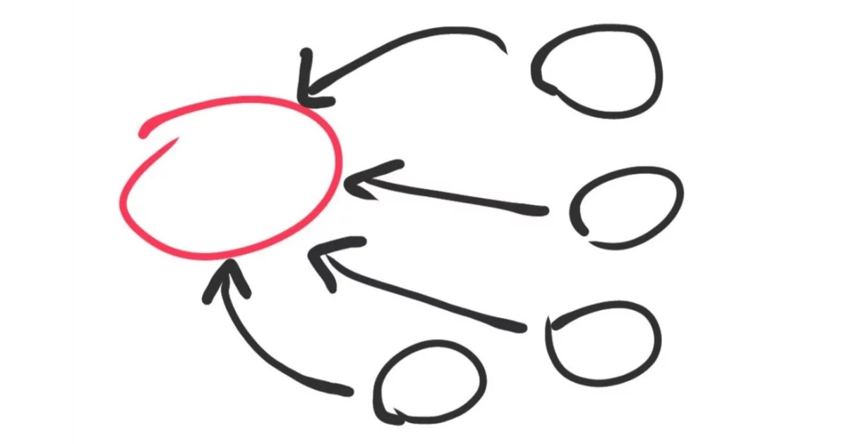
Conclusion
Notes:
I see event sourcing as an implementation strategy for the persistence of state, e.g. of aggregates. This strategy should not be exposed beyond the boundaries of aggregates. The events from event sourcing should therefore only be used internally in the corresponding aggregate or in the context of CQRS to build related read models.
Domain events, on the other hand, represent a specific fact or happening that is relevant regardless of the type of persistence strategy for aggregates, for example, for integrating bounded contexts.
Event sourcing and domain events can of course be used both at the same time, but should not influence each other. The two concepts are used for different purposes and should therefore not be mixed.

Slide 50
References

Slide 51
https://dev.to/barryosull/event-sourcing-what-it-is-and-why-its-awesome
https://eventuate.io/whyeventsourcing.html
https://medium.com/@hugo.oliveira.rocha/what-they-dont-tell-you-about-event-sourcing-6afc23c69e9a
https://dddcommunity.org/learning-ddd/what_is_ddd/
https://www.thoughtworks.com/insights/blog/domain-driven-design-services-architecture
https://dev.to/stefanpavlovic94/domain-driven-design-first-thoughts-part-one-232f
https://airbrake.io/blog/software-design/domain-driven-design
https://www.innoq.com/en/blog/domain-events-versus-event-sourcing/#eventsourcingandcqrs
https://docs.microsoft.com/en-us/azure/architecture/patterns/cqrs
https://martinfowler.com/bliki/CQRS.html

Slide 52
Thank you!
Contact.OussamaZEBDA@gmail.com

